Slide 1
Raspberry GPIO

Slide 2
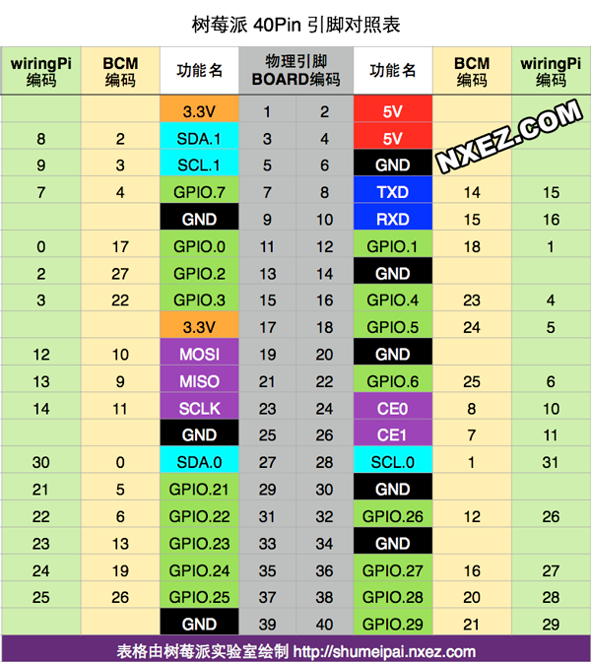
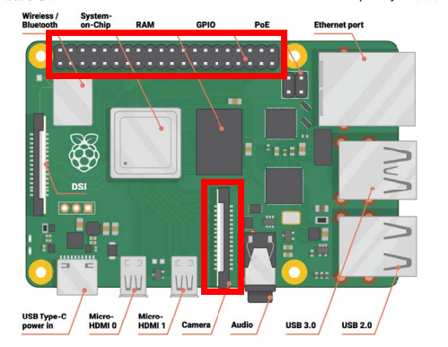
禁止使用5V电源
禁止将电源回接到GPIO口
Raspberry Pi

Slide 3
GPIO.setwarnings(False)
GPIO.setmode(GPIO.BOARD)
# GPIO channel mode:
# channel: GPIO pin
# mode: GPIO.OUT, GPIO.IN,
# para for GPIO.OUT, initial=GPIO.LOW/GPIO.HIGH
# para for GPIO.IN, pull_up_down=GPIO.PUD_UP/GPIO.PUD_DOWN
GPIO.setup(channel, mode, para)
# GPIO pin output:
# channel: GPIO pin
# state: GPIO.LOW/GPIO.HIGH
GPIO.output(channel,state)
# GPIO pin input:
# channel: GPIO pin
GPIO.input(channel)
# Clean GPIOs
GPIO.cleanup()
GPIO

Slide 4
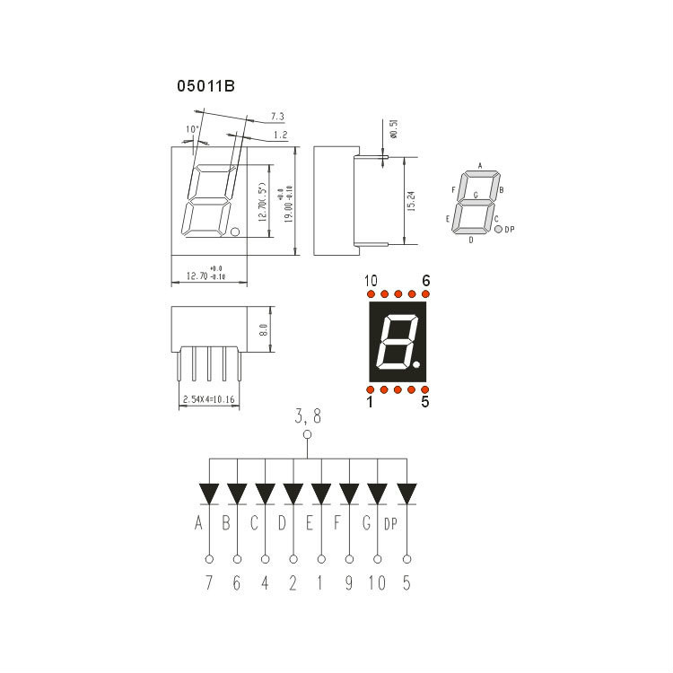
Digital Tube

Slide 5
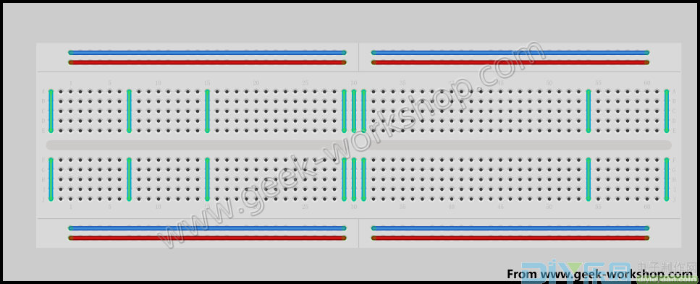
Connection
GND
Vcc
Circuit
Breadboard

